Slide 1
Notes:
Welcome.

Slide 2
HAVE YOU EVER THOUGHT ABOUT DIRECTING YOUR OWN MOVIES?

Slide 3
HAVE YOU EVER WANTED TO STIMULATE YOUR CREATIVITY BUT DIDN’T KNOW EXACTLY HOW?

Slide 4
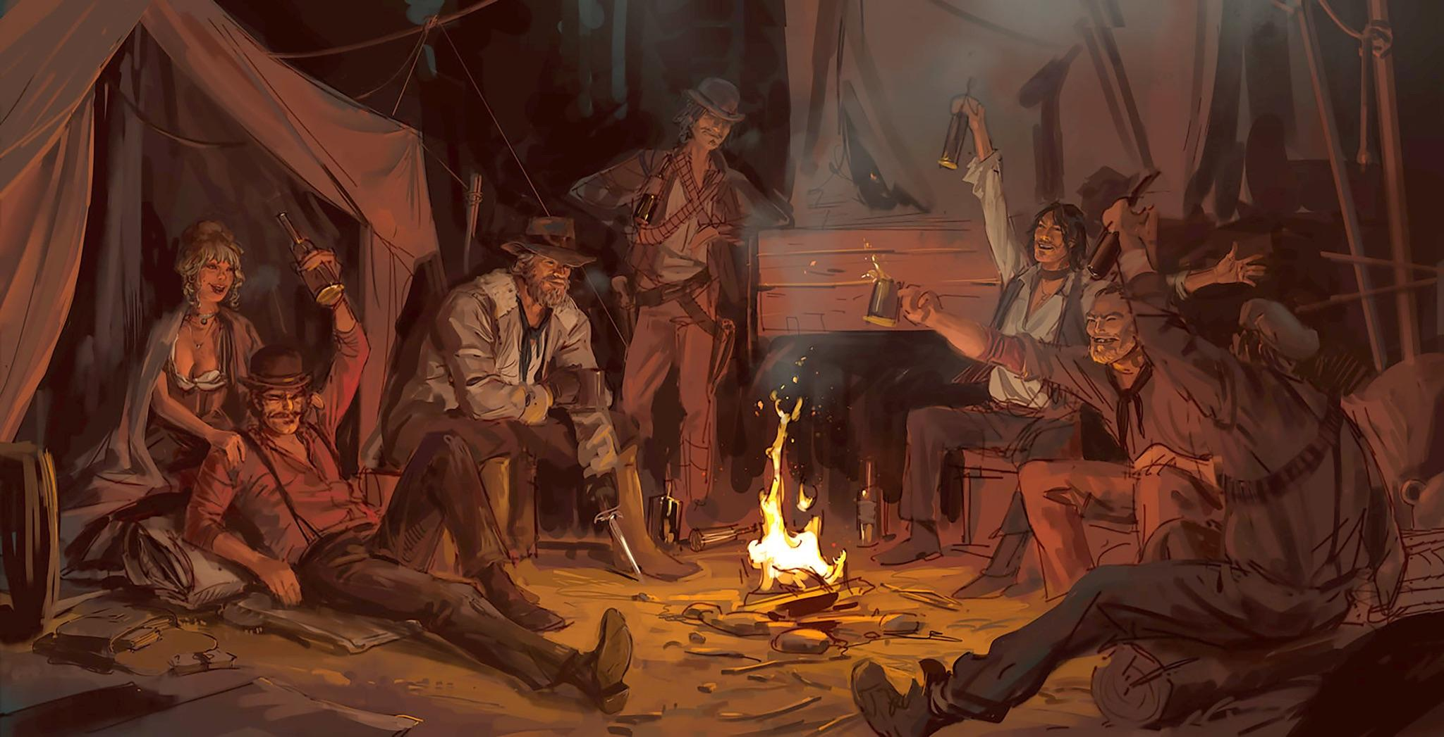
RED DEAD REDEMPTION 2—CONCEPT ART
DAREN BADER/ROCKSTAR GAMES

Slide 5
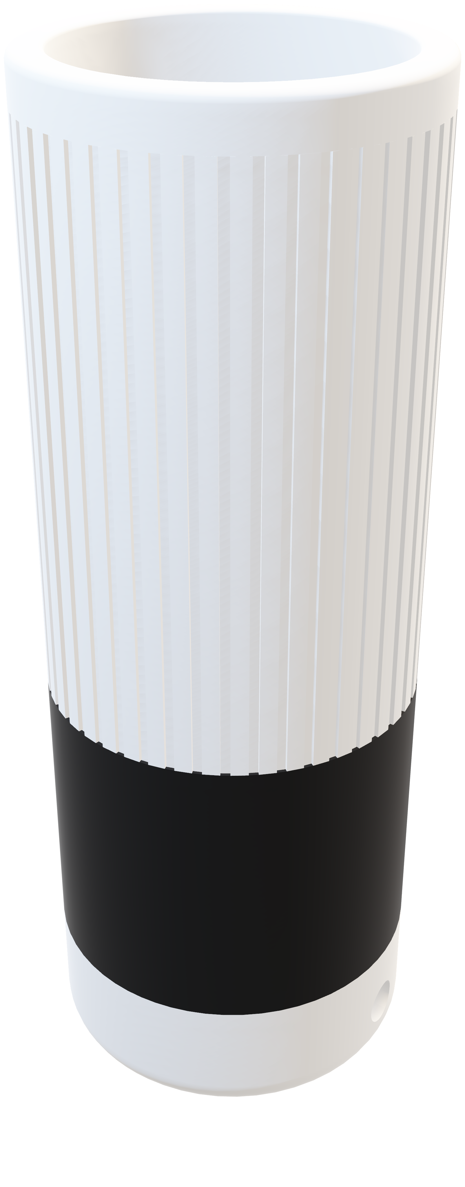
INTRODUCING

Slide 6
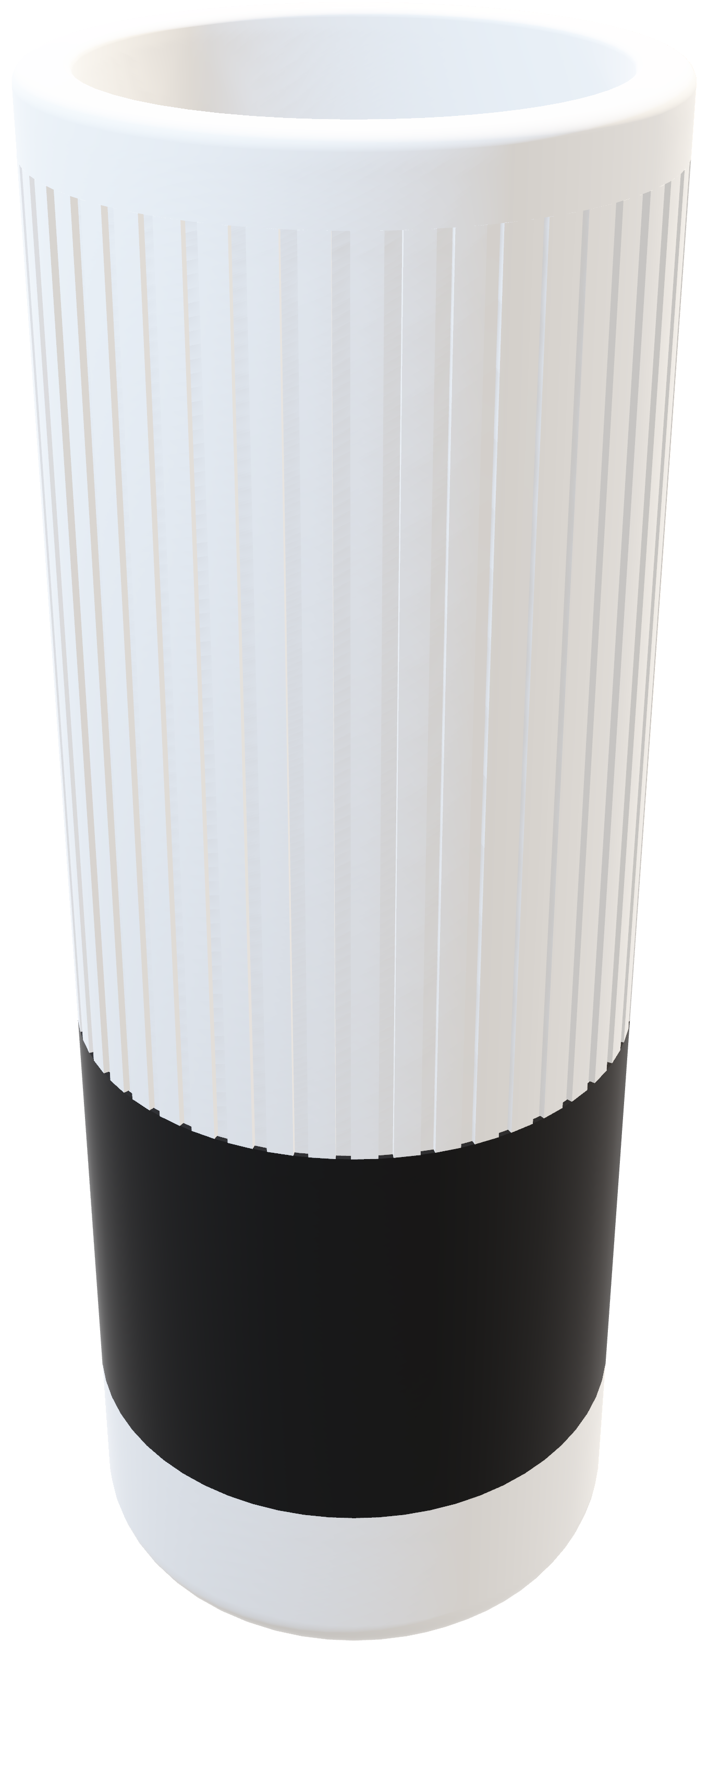

Slide 7
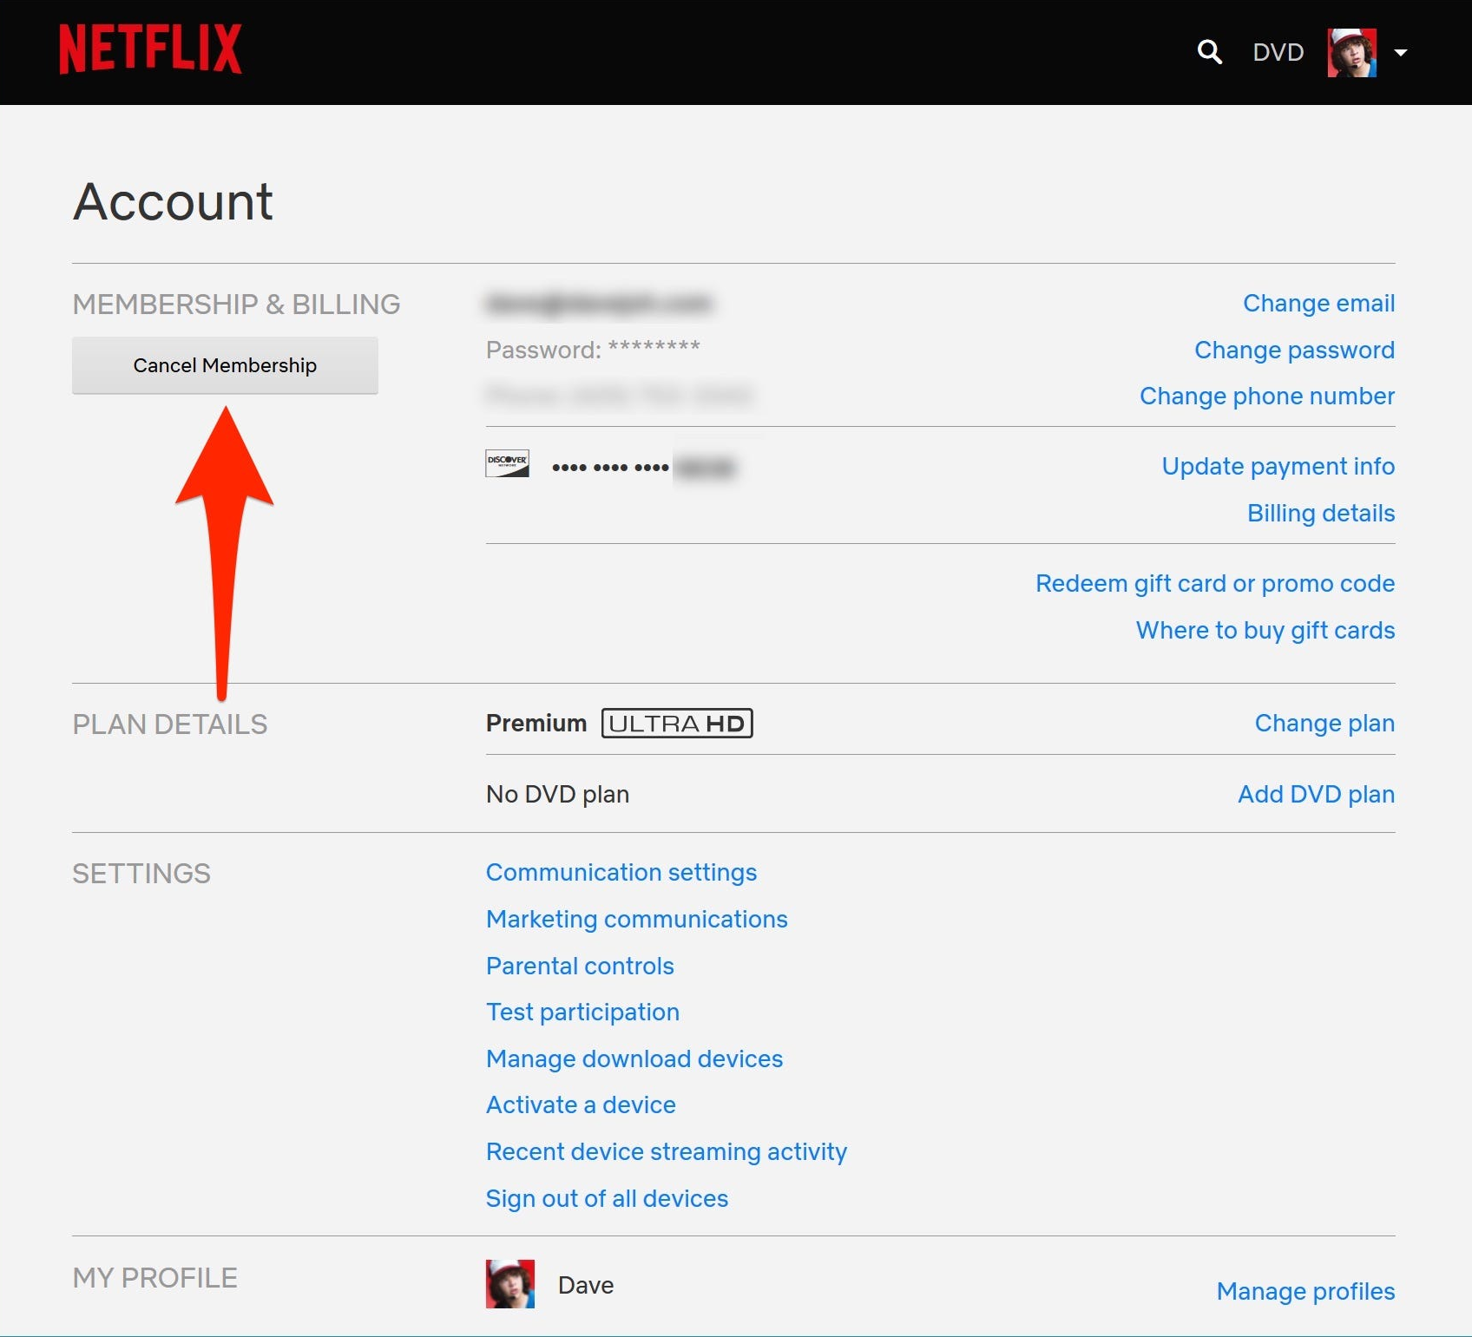

Slide 8
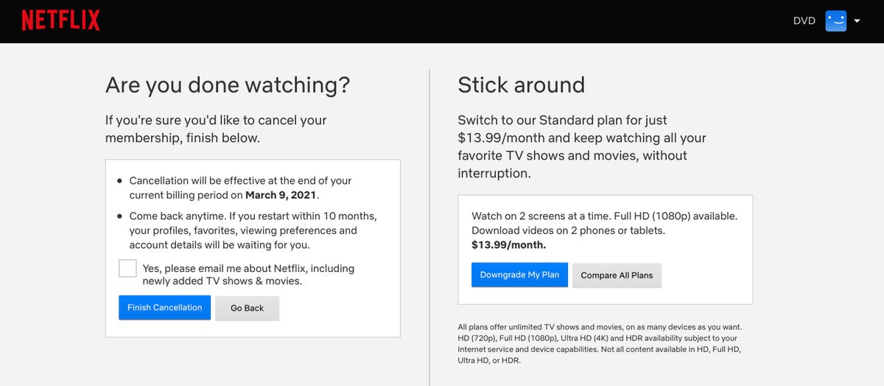

Slide 9
AI ASSISTANT THAT NARRATES STORIES
FOR YOU WHILE DRAWING

Slide 10
EPISODES AND SERIES

Slide 11
CHIPS INSIDE OF PENS
RFID+NFC

Slide 12
STORY
TEXTURE
FEELING

Slide 13
WHERE IS THE AI PART?

Slide 14
#INTRO
#EVENT1
#EVENT2
#EVENT3
#ENDING

Slide 15
ALIVE STORIES

Slide 16

DEMO

Slide 17

BEAUTIFUL INDUSTRIAL DESIGN
SIMPLE INTERACTION
AI-GENERATED STORIES

Slide 18

ADAM CHATIR, 2024
MASTER MEDIA DESIGN
HEAD-GENÈVE × CARAN D’ACHE

